Slide 1
Refinement of a Methyl Torsional Potential against Quasi-elastic Neutron Scattering Experiments

Slide 2
Refinement Strategy
We aim to refine a single parameter in a molecular dynamics force-field by comparison against Quasi Elastic Neutron Scattering (QENS) experiments
Typical scenarios when single parameter refinement is warranted:
Diffusion highly sensitive to a single parameter (QENS signal determined by H’s)
Coarse-grained simulations (few parameters)
Simple strategy: Perform a series of simulations in a range of parameter values, each with a fixed value of force-field parameter K.
K
K₁
K₂
K₃
K*
K_{n}
Optimal value to be found
Main advantage: simulations are run in parallel ( take less than a day )

Slide 3
Refinement Workflow
K
Remote cluster
Local Workstation
K_{N}
EQUILIBRATION
PRODUCTION
N simulations
I_{i}
S_{i}
S
S
(
(
(
(
Q, t
Q, E
Q, E,
K
Q, E,
K*
(
(
(
(
K₂
K₁
A
B
C
Molecular
Dynamics
Intermediate Scattering law
A:
Scattering Law
B:
Smoothing/Interpolation
C:
Optimization→ yields K*

Slide 4
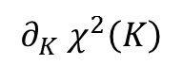
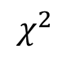
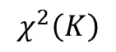
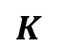
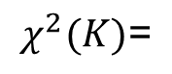
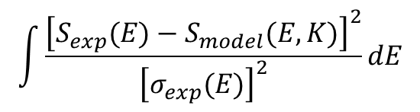
The Sampling Problem
Observation: Molecular Dynamics (MD) simulations are finite in time and size.
→ Errors in the correlation functions
Why do we care?
Errors produce a rugged landscape in
is ill defined
Minimization of will get stuck in a
(false) local minimum.
$$\int{\frac{{\left[S_{exp}(E)−S_{model}(E,K)\right]}^{2}}{{\left[σ_{exp}(E)\right]}^{2}}dE}$$
$$χ^{2}$$
$$χ^{2}(K)\text{=}$$
$${∂_{K}^{}χ}^{2}\left(K\right)$$
$$χ^{2}\left(K\right)$$
$$K$$
We must smooth and interpolate the set of scattering laws prior to optimization.

Slide 5
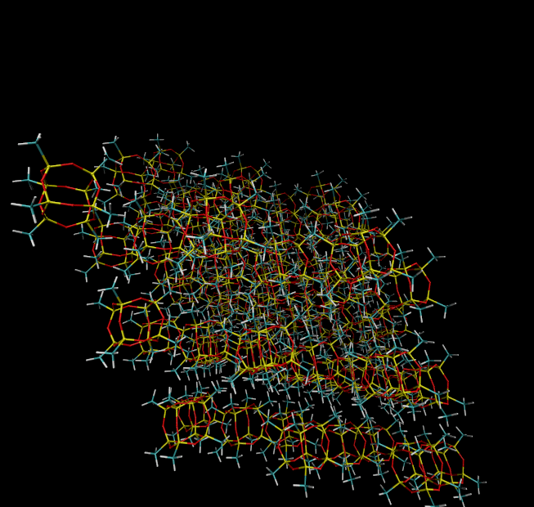
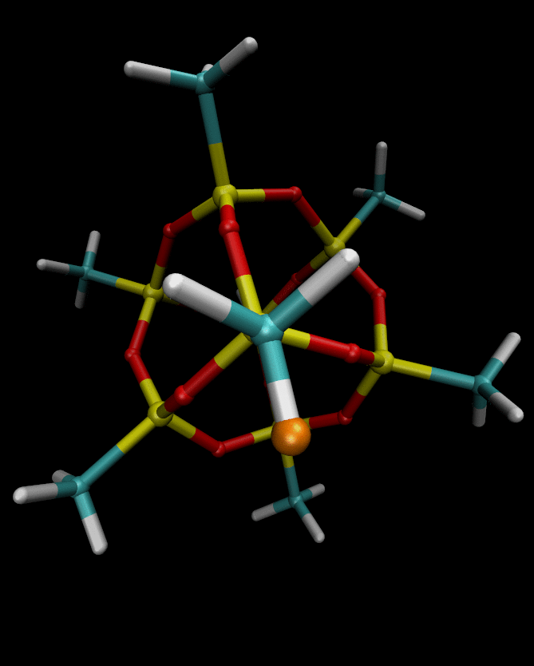
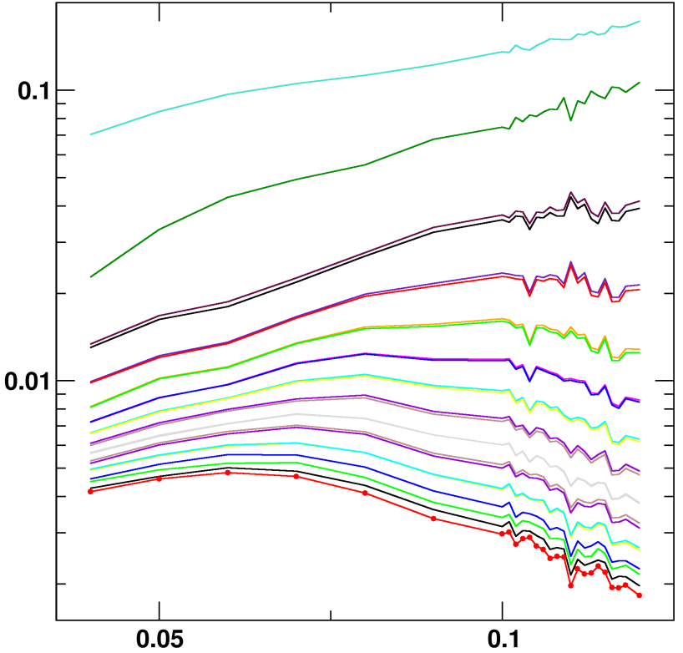

The Sampling Problem: Example
Methyl rotations in Octa-Methyl Silsesquioxanes
Methyl Rotations
0.10meV
Q=0.9Å⁻¹
$$V\left(φ\right)=K[1+cos\left(3φ\right)]$$
0.09meV
S( K | Q,E )
-0.11meV
-0.12meV
K (Kcal/mol)
-0.13meV
Simulation-derived scattering laws are not smooth

Slide 6
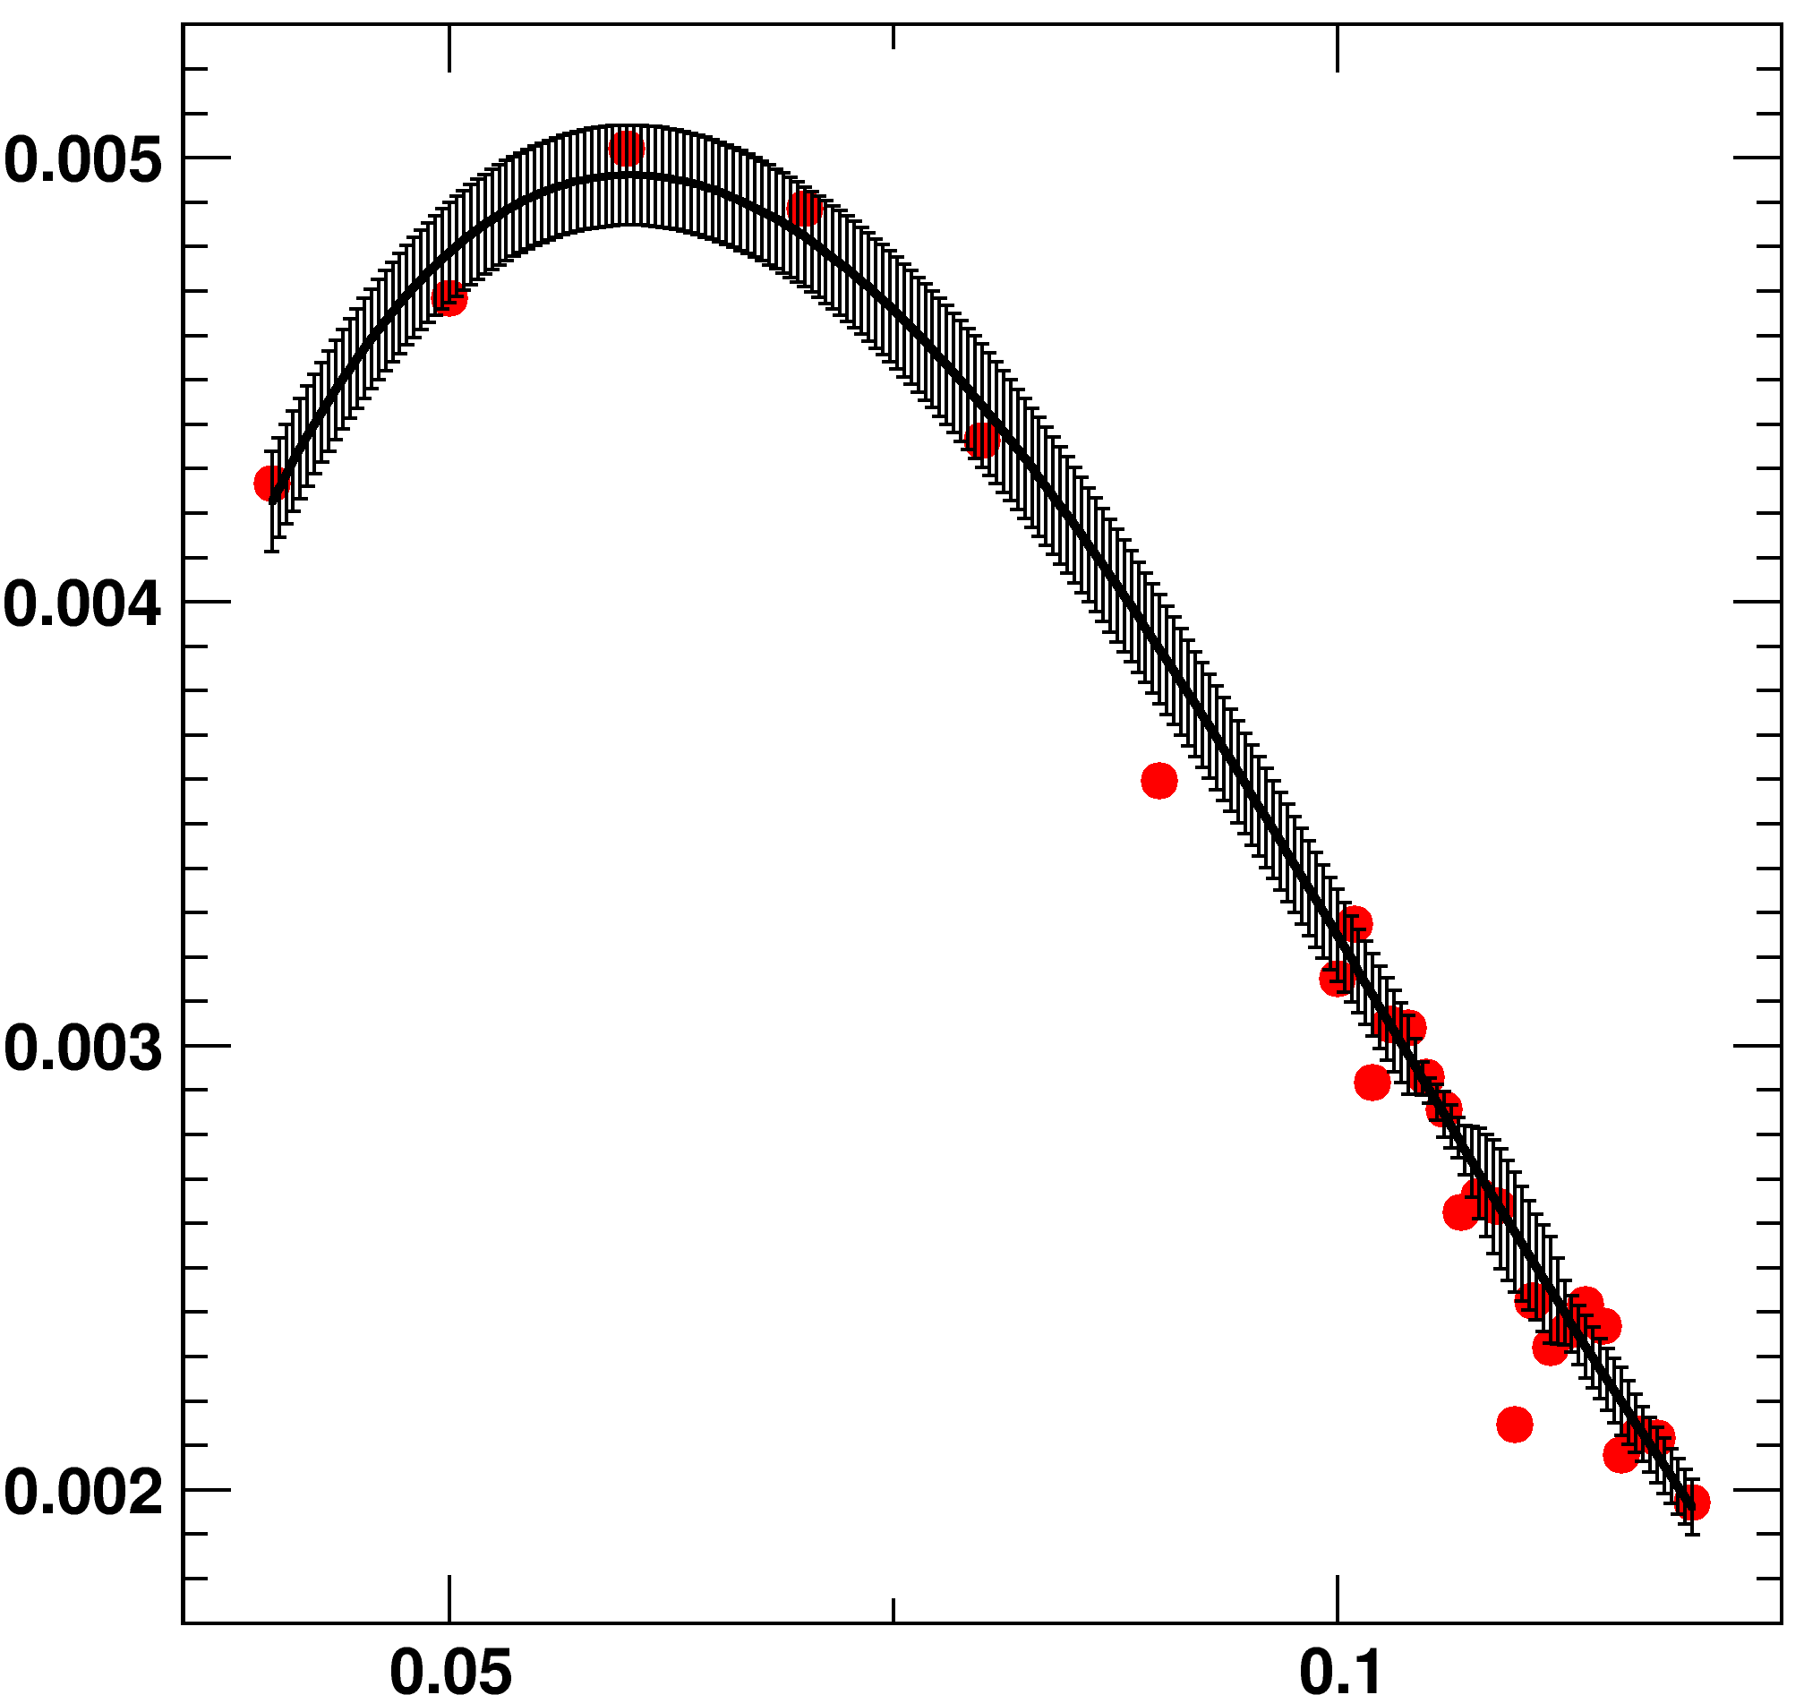
Smoothing the Scattering Law
Start with the set of simulation-derived scattering laws { S(K_{i}) }
Go through every point K_{i} and perform a local regression
After this local regression, the blue point substitutes the red point.
S( K | Q,E )
K (Kcal/mol)
After the local regression step, we end up with a new set of scattering laws, and associated errors
{ S(K_{i}) } → { S’(K_{i}) ± σ(K_{i}) }

Slide 7
Smoothing the Scattering Law
Construct spline: { S’(K_{i}) ± σ(K_{i}) } →S(K) ±σ(K)
Spline is smooth, suitable for optimization
S( K | Q,E )
K (Kcal/mol)
Spline does not necessary pass through the original (K_{i} ,S(K_{i})) points

Slide 8
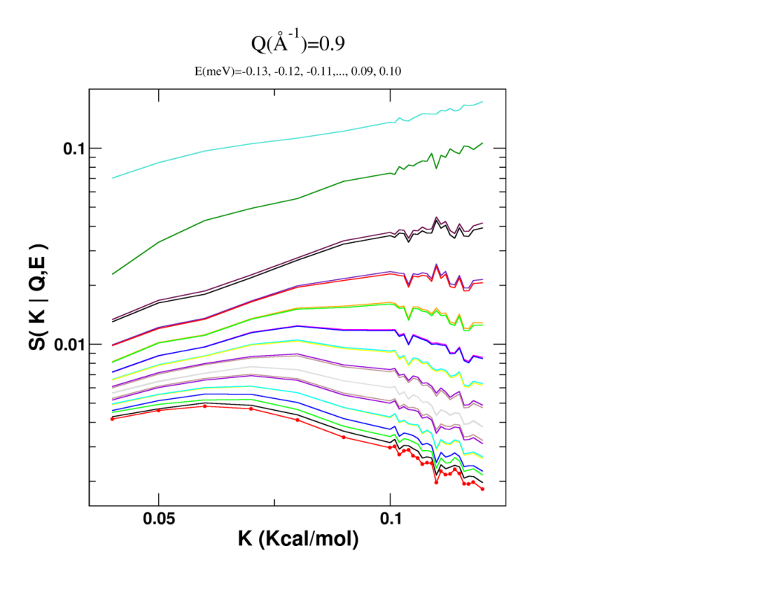
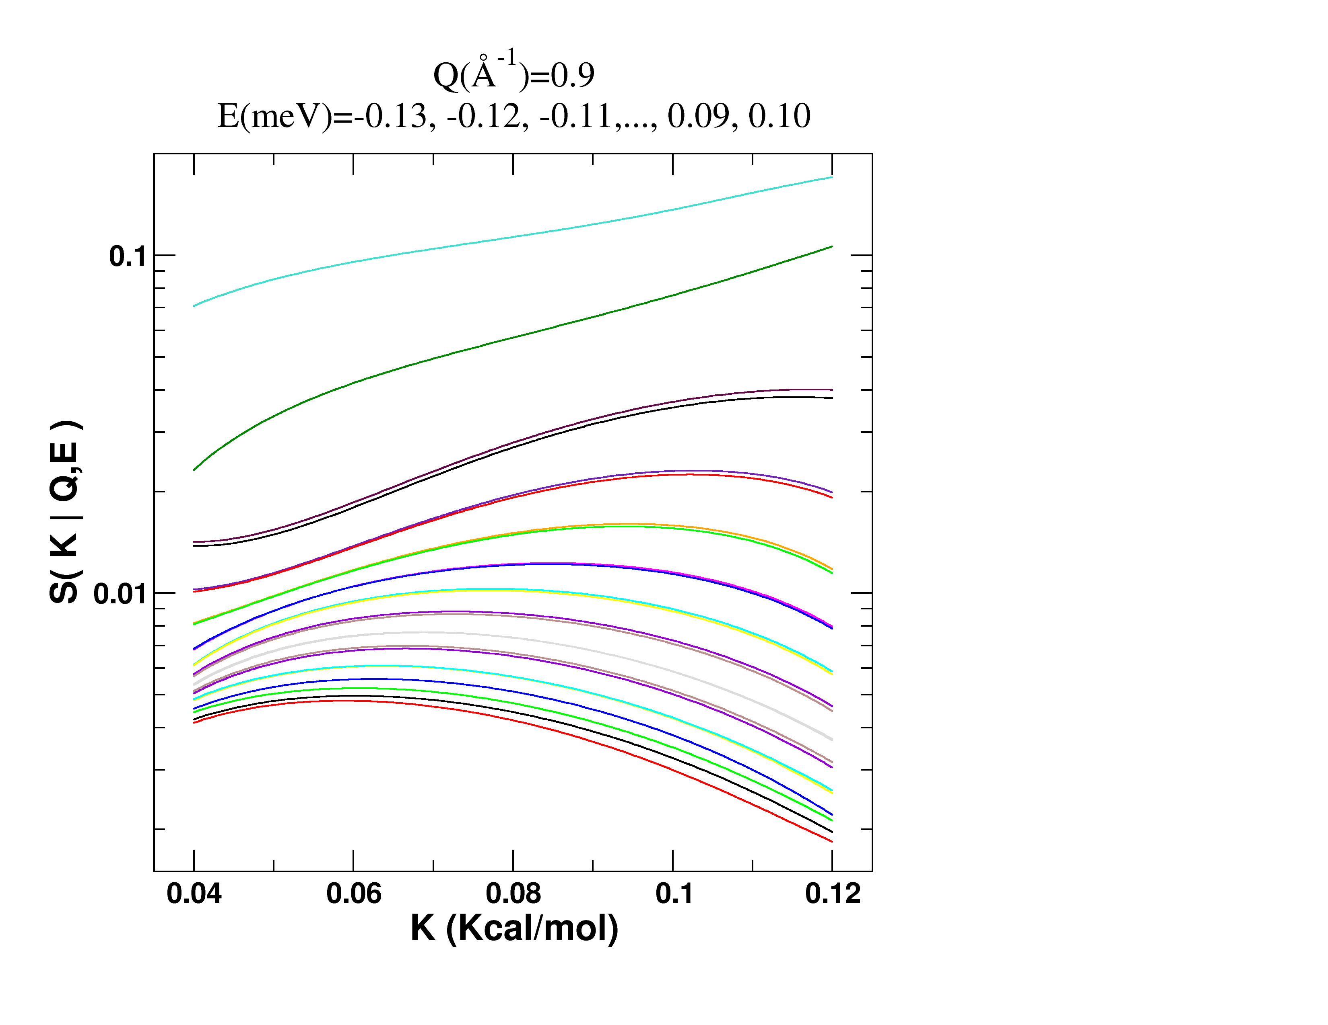
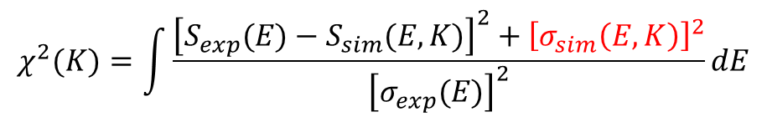
Smoothing the Scattering Law
S( K | Q,E )
S( K | Q,E )
K (Kcal/mol)
K (Kcal/mol)
S(K,Q,E) is smooth and derivable, like an analytical model
σ(K,Q,E) error estimation for the simulations
$$χ^{2}(K)=\int{\frac{{\left[S_{exp}(E)−S_{sim}(E,K)\right]}^{2}+{\left[σ_{sim}\left(E,K\right)\right]}^{2}}{{\left[σ_{exp}(E)\right]}^{2}}dE}$$

Slide 9
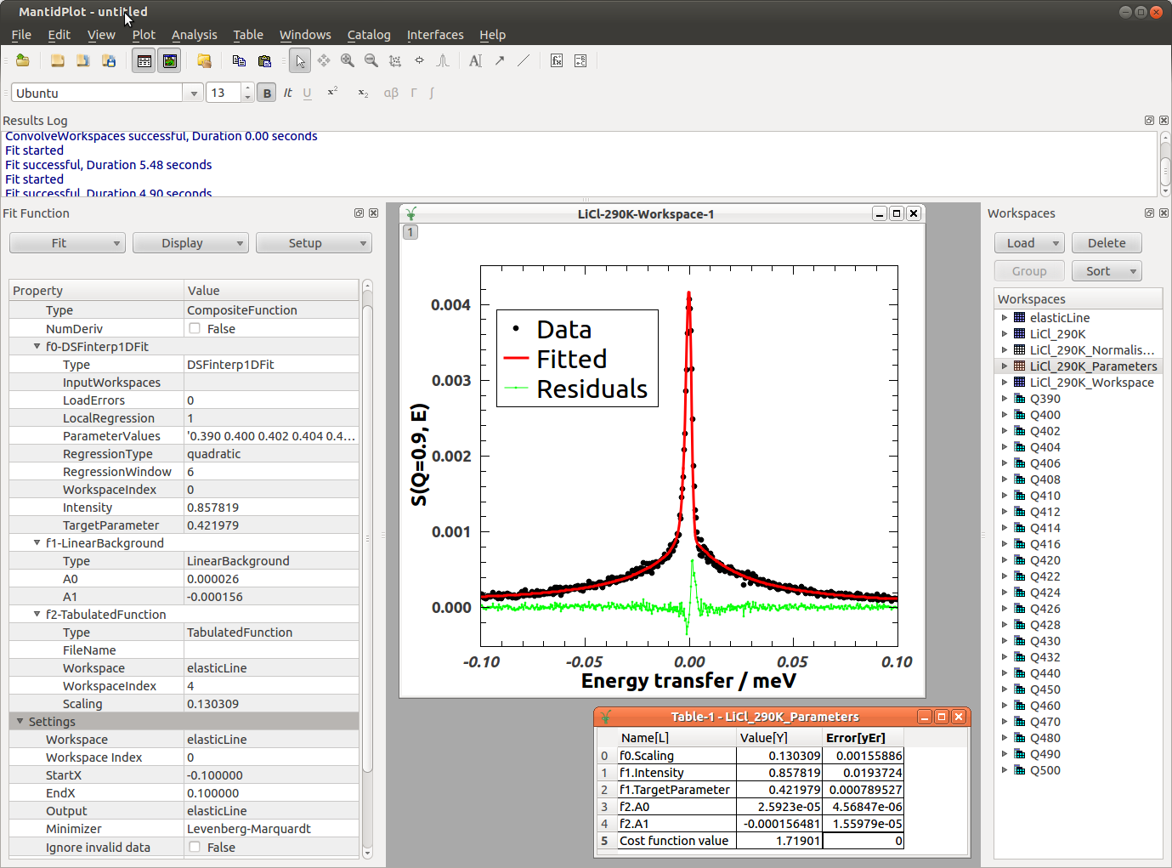
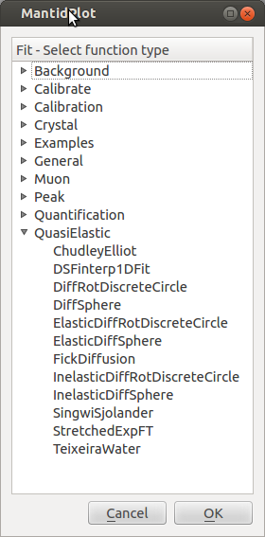
Implementation in Mantid: DSFinterp1DFit
http://www.mantidproject.org/DSFinterp1DFit

Slide 10
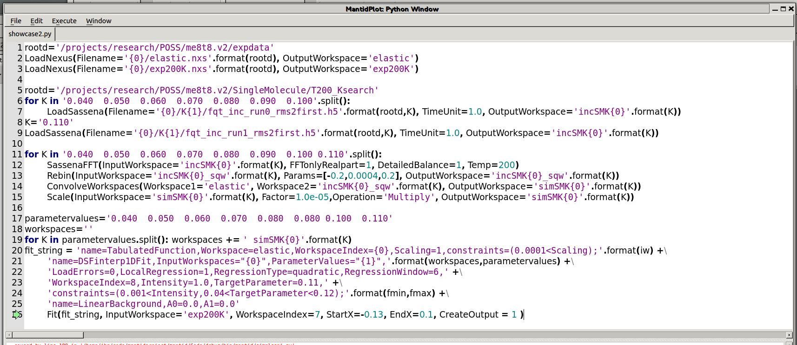
Fit Using the Script Window
$Smodel\left(Q,E\right)=Res(Q,E)⊗\left[a_{0}(Q)∙δ\left(E\right)+a_{1}(Q)∙S_{sim}(Q,E)\right]$+ L.B.
Load experimental S(Q,E) and resolution
Load simulated I(Q,t,K_{i})
Fourier Transform and convolve with resolution
Define the fit function
a₀*R(Q,E)+a₁*S(Q,E)+LB

Slide 11
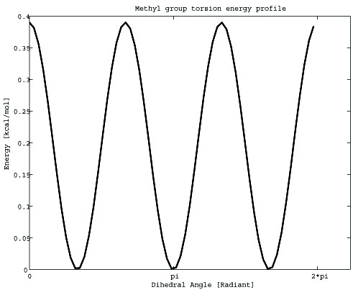
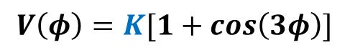
Test: Octa-Methyl Silsesquioxane
Methyl Rotations
$$V\left(φ\right)=K[1+cos\left(3φ\right)]$$
2K
Experiments at BASIS@SNS: E_{a}=1.22 Kcal/mol → K_{exp}=0.068 Kcal/mol
Initial guess K=0.11 Kcal/mol (off by 62%)
Eight NVT simulations of a single molecule, each 10ns long, at T=200K
K={0.04, 0.05, … , 0.11}

Slide 12
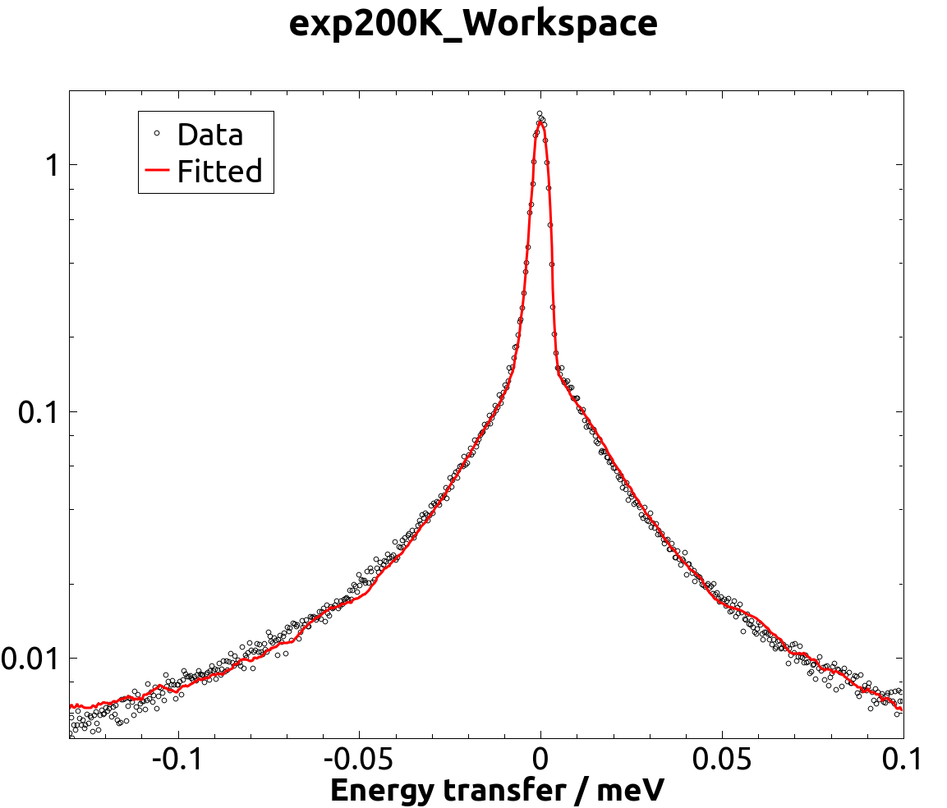
Test: Octa-Methyl Silsesquioxane
$Smodel\left(Q,E\right)=Res(Q,E)⊗\left[a_{0}(Q)∙δ\left(E\right)+a_{1}(Q)∙S_{sim}(Q,E)\right]$+ L.B.
Q=1.1Å⁻¹
Q L K* Χ²
0.3 20.9 0.06354 1.83
0.5 12.6 0.06350 2.44
0.7 9.0 0.06313 2.20
0.9 7.0 0.06398 2.69
1.1 5.7 0.06472 2.43
1.3 4.8 0.06495 2.54
1.5 4.2 0.06508 2.89
1.7 3.7 0.06518 3.55
1.9 3.3 0.06493 4.13
< K* >_{Q}= 0.0643 Kcal/mol
(off by 5%)
Derivation of K* from a single temperature (200K)

